Slide 1
FIFA WORLD CUP ANALYSIS

Slide 2
INTRODUCTION
FIFA World Cup is a global football competition contested by the various football-playing nations of the world. It is contested every four years and is the most prestigious and important trophy in the sport of football.
The FIFA World Cup, often simply called the World Cup, is an international association football competition between the senior men's national teams of the members of the Fédération Internationale de Football Association (FIFA), the sport's global governing body. The tournament has been held every four years since the inaugural tournament in 1930, with the exception of 1942 and 1946 due to the Second World War.

Slide 3

Details of Data
It contains 3 datasets.
First dataset contains information about all the matches.
Second dataset contains information about all the teams and players.
Third dataset contains information about all the WorldCup.

Slide 4
Main KPI’s
Total Attendance – 38,390,080
Total Matches Played - 836
Total Goals Scored - 2379
Total Teams - 82

Slide 5
Insights
In 2014, Highest Nos of People attended the Matches.
Germany, France, Brazil, Italy, Mexico have won two world cups each,
In 1930, Only 18 matches were played between 13 Countries, while from 1998, 32 teams started playing 64 matches.
Antonio Carbajal from Mexico have scored mostly 5 goals then at second, Diego Maradona from Argentina scoring 4 goals comes.
Brazil had most matches Wins 82 while Italy comes second winning 56 matches.
In 2014, 206 goals scored as 99 away goals and 107 home goals which is highest.

Slide 6
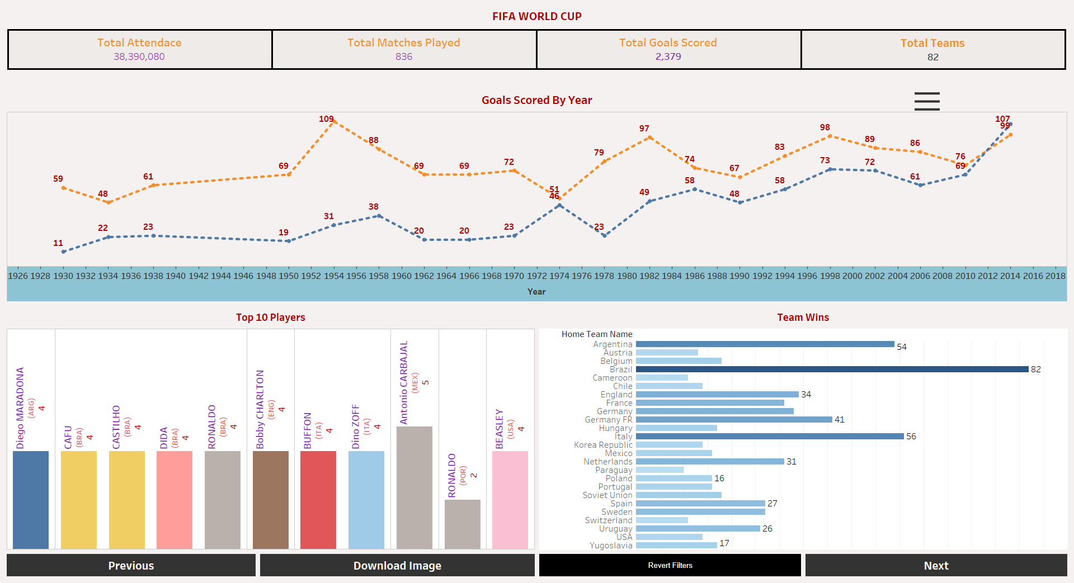
Mock-Up Dashboard

Slide 7
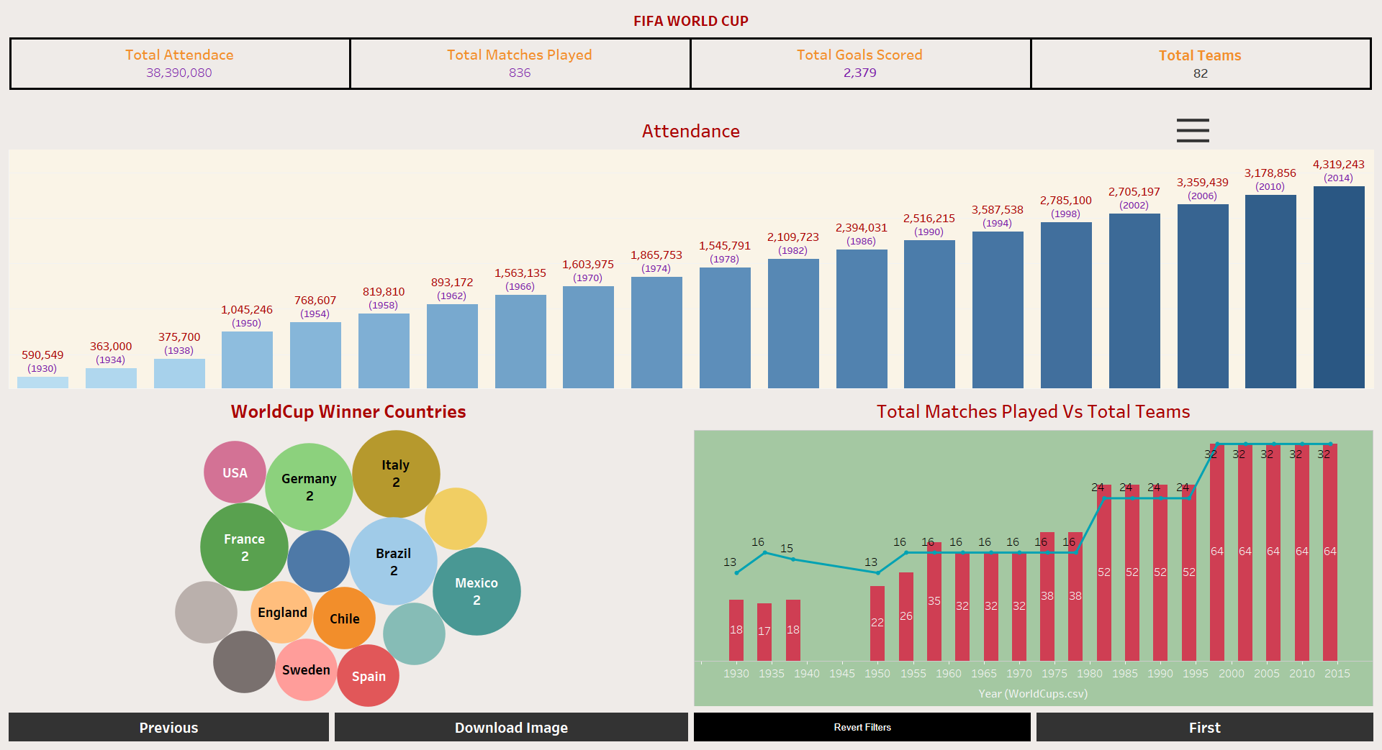

Slide 8

This Photo by Unknown Author is licensed under CC BY-SA

